Slide 1

Employee Management System
Presented By:
Gouti Sagar
Vamshi Krishna Mummadi

Slide 2
Agenda
Objective of the Project
ER Diagram and schema explanation
Key analysis questions
SQL query results with screenshots or summaries
Final business insights and recommendations
Challenges working on SQL
Q&A Slide
Conclusion

Slide 3
Objective
To design and implement a centralized Employee Management System that organizes employee related data in a structured relational database. The system supports efficient storage, retrieval, and maintenance of records across the organization.
To track essential employee information including personal details, job roles, salary structures, qualifications, leave records, and payroll data. Each data component is stored in dedicated tables to avoid redundancy and improve clarity.
To enable efficient querying and analysis of employee data for payroll calculation, leave tracking, and department-wise reporting. The system provides meaningful insights to support HR and financial decision making.

Slide 4
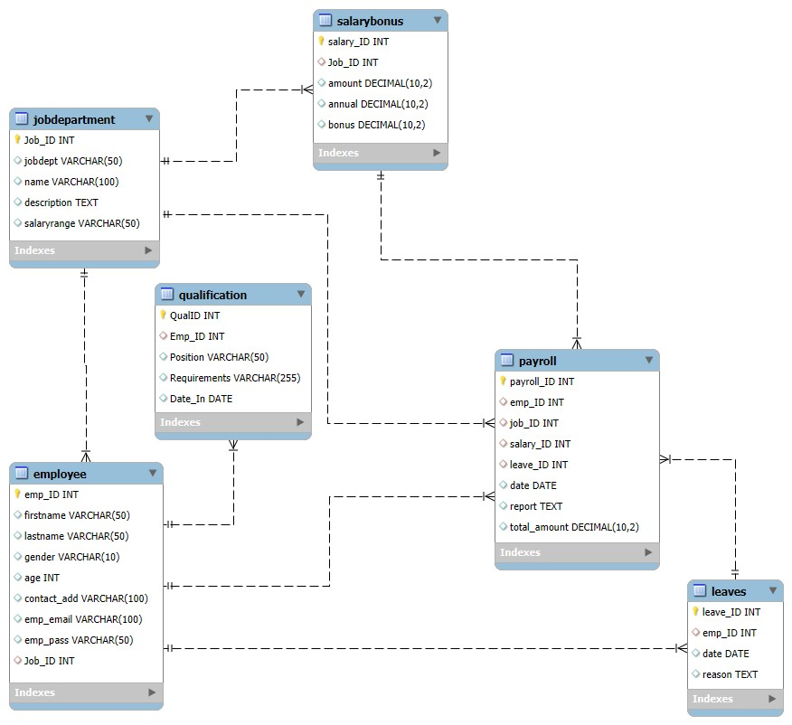
ER Diagram and Schema Explanation
Relationships
One-to-Many from JobDepartment to Employees
One-to-Many from Employee to Qualifications
One-to-Many` from Employee to Leaves
One-to-Many from Employee to Payroll records
One-to-one from JobDepartment to SalaryBonus

Slide 5
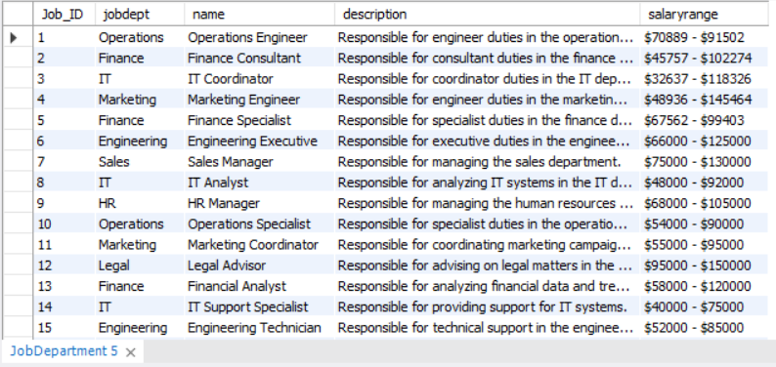
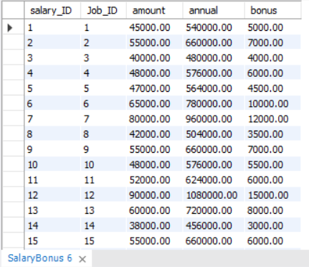
Tables
1. Job Department
2. Salary Bonus

Slide 6
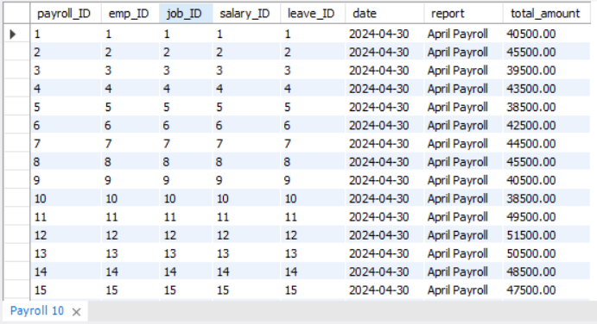
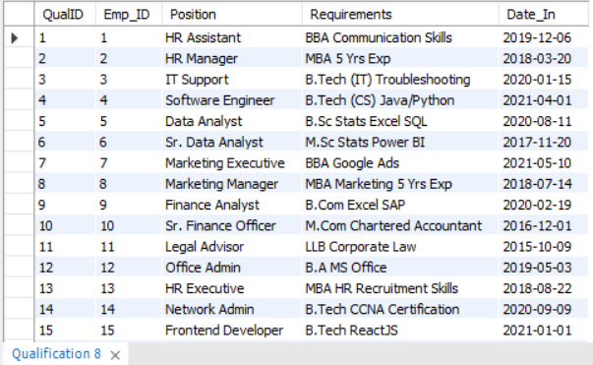
Tables
3. Payroll
4. Qualification

Slide 7
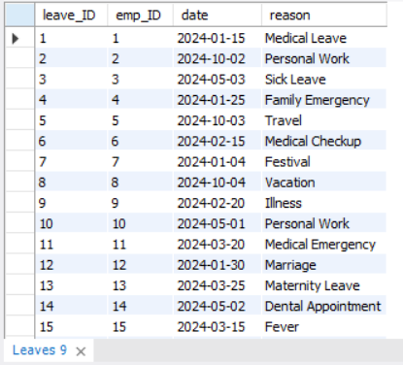
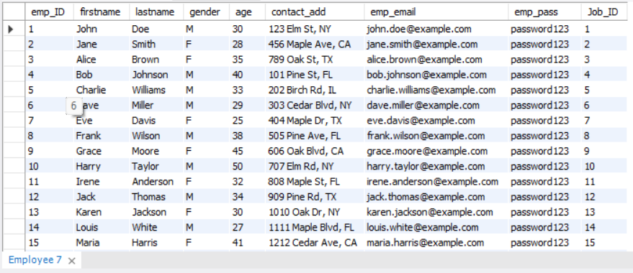
Tables
5. Leaves
6. Employee

Slide 8
Key Analysis Questions
1. EMPLOYEE INSIGHTS
How many unique employees are currently in the system?
Which departments have the highest number of employees?
What is the average salary per department?
Who are the top 5 highest-paid employees?
What is the total salary expenditure across the company?
2. JOB ROLE AND DEPARTMENT ANALYSIS
How many different job roles exist in each department?
What is the average salary range per department?
Which job roles offer the highest salary?
Which departments have the highest total salary allocation?

Slide 9
Key Analysis Questions
3. QUALIFICATION AND SKILLS ANALYSIS
How many employees have at least one qualification listed?
Which positions require the most qualifications?
Which employees have the highest number of qualifications?
4. LEAVE AND ABSENCE PATTERNS
Which year had the most employees taking leaves?
What is the average number of leave days taken by its employees per department?
Which employees have taken the most leaves?
What is the total number of leave days taken company-wide?
How do leave days correlate with payroll amounts?

Slide 10
Key Analysis Questions
5. PAYROLL AND COMPENSATION ANALYSIS
What is the total monthly payroll processed?
What is the average bonus given per department?
Which department receives the highest total bonuses?
What is the average value of total_amount after considering leave deductions?

Slide 11
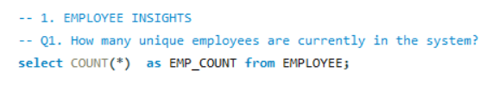

SQL Query Results with Screenshots
Employee Insights
1. How many unique employees are currently in the system?

Slide 12
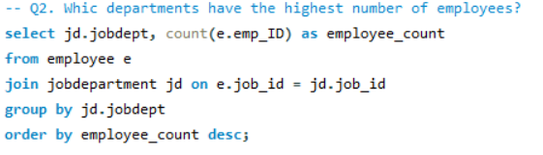
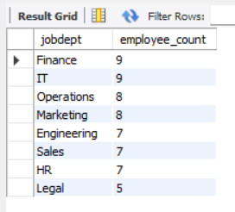
SQL Query Results with Screenshots
2. Which departments have the highest number of employees?

Slide 13
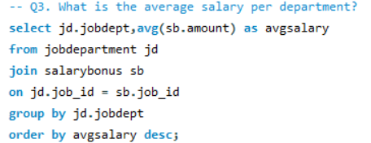
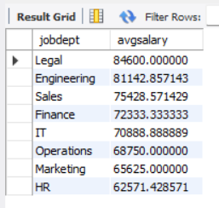
SQL Query Results with Screenshots
3. What is the average salary per department?

Slide 14
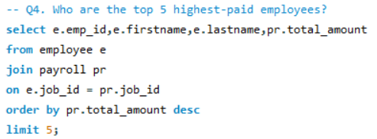
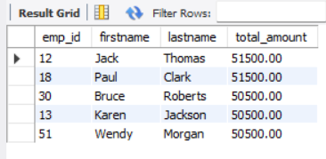
SQL Query Results with Screenshots
4. Who are the top 5 highest-paid employees?

Slide 15

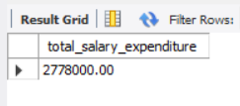
SQL Query Results with Screenshots
5. What is the total salary expenditure across the company?

Slide 16
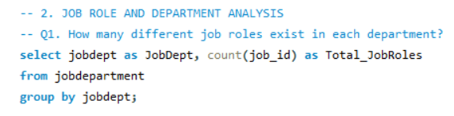
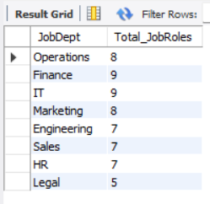
SQL Query Results with Screenshots
JOB ROLE AND DEPARTMENT ANALYSIS
1. How many different job roles exist in each department?

Slide 17
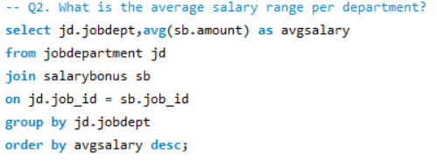
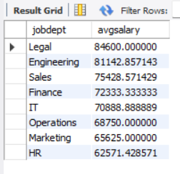
SQL Query Results with Screenshots
2. What is the average salary range per department?

Slide 18
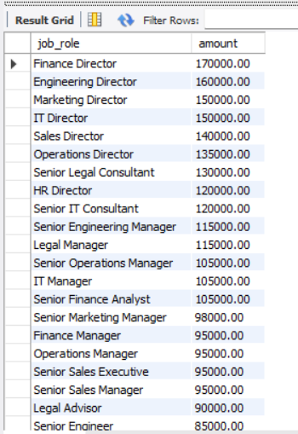
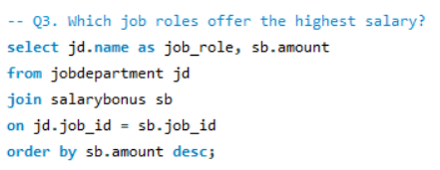
SQL Query Results with Screenshots
3. What job roles offer the highest salary?

Slide 19
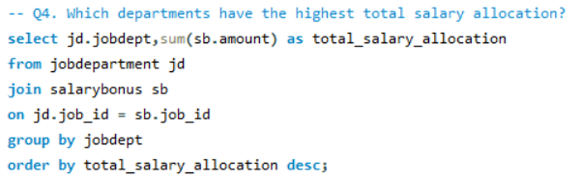
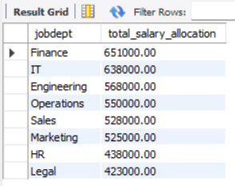
SQL Query Results with Screenshots
4. Which departments have the highest total salary allocation?

Slide 20
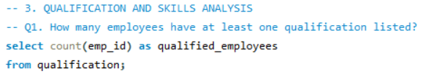

SQL Query Results with Screenshots
QUALIFICATION AND SKILLS ANALYSIS
1. How many employees have at least one qualification listed?

Slide 21
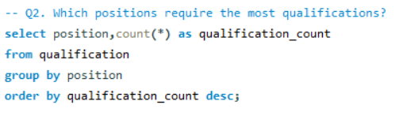
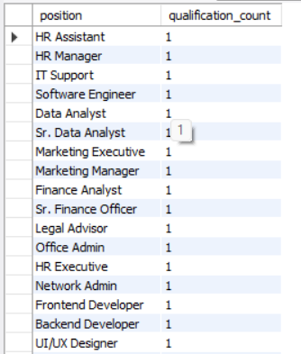
SQL Query Results with Screenshots
2. Which positions require the most qualifications?

Slide 22
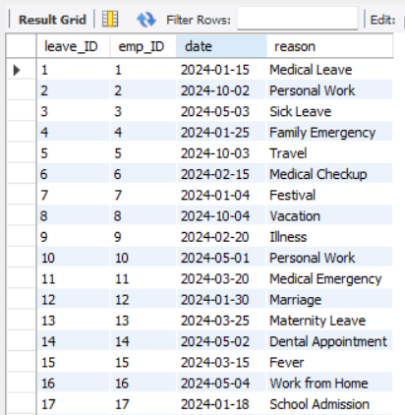
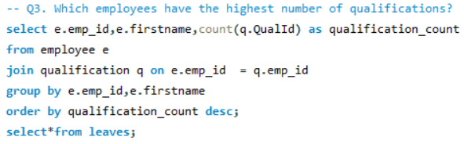
SQL Query Results with Screenshots
3. Which employees have the highest number of qualifications?

Slide 23
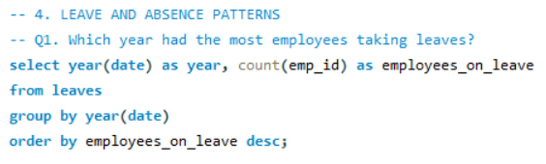

SQL Query Results with Screenshots
LEAVE AND ABSENCE PATTERNS
1. Which year had the most employees taking leaves?

Slide 24
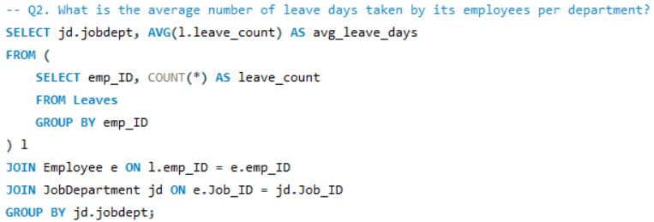
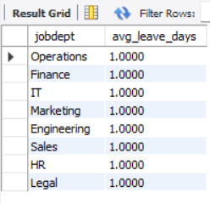
SQL Query Results with Screenshots
2. What is the average number of leave days taken by its employees per department?

Slide 25
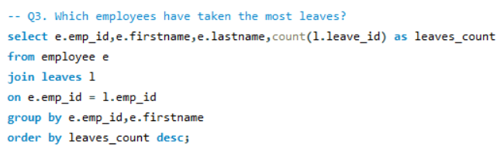
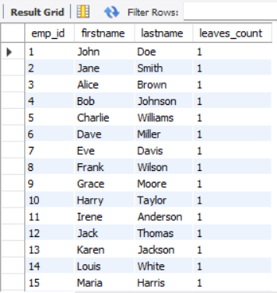
SQL Query Results with Screenshots
3. Which employees have taken the most leaves?

Slide 26
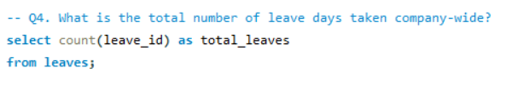

SQL Query Results with Screenshots
4. What is the total number of leave days taken company-wide?

Slide 27
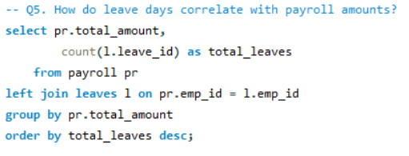
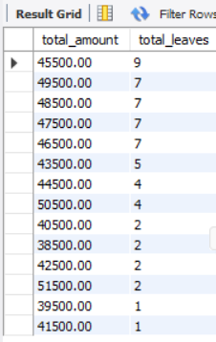
SQL Query Results with Screenshots
5. How do leave days correlate with payroll amounts?

Slide 28
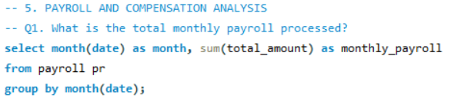

SQL Query Results with Screenshots
PAYROLL AND COMPENSATION ANALYSIS
1. What is the total monthly payroll processed?

Slide 29
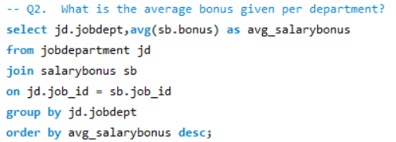
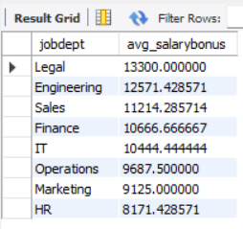
SQL Query Results with Screenshots
2. What is the average bonus given per department?

Slide 30
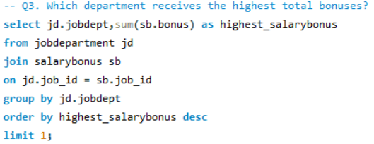

SQL Query Results with Screenshots
3. Which department receives the highest total bonuses?

Slide 31


SQL Query Results with Screenshots
4. What is the average value of total_amount after considering leave deductions?

Slide 32
Final Business Insights
Workforce distribution is uneven across departments, indicating potential overstaffing in some areas and capacity gaps in others, which can be optimized for better resource utilization.
Salary allocation varies significantly by department and job role, confirming that compensation is strongly driven by role complexity and departmental function.
Actual payroll expenditure differs from planned salary structures, highlighting the impact of bonuses, leave deductions, and attendance on real financial outflow.
Employees with higher qualification levels are concentrated in specific roles, suggesting that skill-intensive positions demand continuous training and certification investment.
Payroll data provides a more accurate picture of company expenditure than salary definitions alone, reinforcing the importance of transaction-level data for financial planning.

Slide 33
Recommendations
Invest in skill development for high-demand roles
Control bonus distribution through performance linkage
Align salary structures with actual payroll outcomes
Optimize workforce allocation across departments
Monitor high leave frequency employees proactively

Slide 34
Challenges
Handling cascading updates and deletions safely
Loading and validating CSV data with constraints
Ensuring consistent date formats for time-based analysis
Differentiating between planned salary and actual payroll data
Maintaining data integrity across multiple related tables

Slide 35
Conclusion
A structured relational database successfully integrated employee, job, leave, and payroll data with strong data integrity.
SQL analysis provided clear insights into workforce distribution, compensation, attendance, and actual payroll expenditure.
The system enables data-driven HR and financial decision-making for better cost control and workforce management.

Slide 36

THANK YOU

